Slide 1

eZ Unconf #2
eZ Publish 5.1 Introduction
Florent Huck – florent.huck@ez.no Philippe Vincent-Royol – philippe.vincent-royol@ez.no
Notes:
Now that you’ve introduced the company, it is important to spend the second half talking about product. This next section allows you to walk through the products at a high level.

Slide 2

Agenda
Welcome to eZ Publish
Dual Core
What's change between eZ 4, 5.0, 5.1 ?
That's one small step for a developper ...
Bundle eZ 5 full stack
Multisite with one repository
Templates override
Deeper in source code
... one giant leap for production !
Cache introduction
Http Cache
Varnish configuration
SLIDE 2
Copyright © 2013 eZ Systems AS - Florent Huck & Philippe Vincent-Royol

Slide 3
Welcome to eZ Publish
Notes:
The following 4 slides allow you to dig deeper into the eZ approach and talk in more specifics about agility, connectivity and empowerment.

Slide 4
eZ Publish 5 – Wall of Fame
Simple Integration with our API
HMVC (Hierarchical Model View Controller) stack
Decoupled Composents
Dependency Injection
New Template Engine
Extensible, Open, Reliable
Backward Compatibility
Copyright © 2013 eZ Systems AS - Florent Huck & Philippe Vincent-Royol

Slide 5
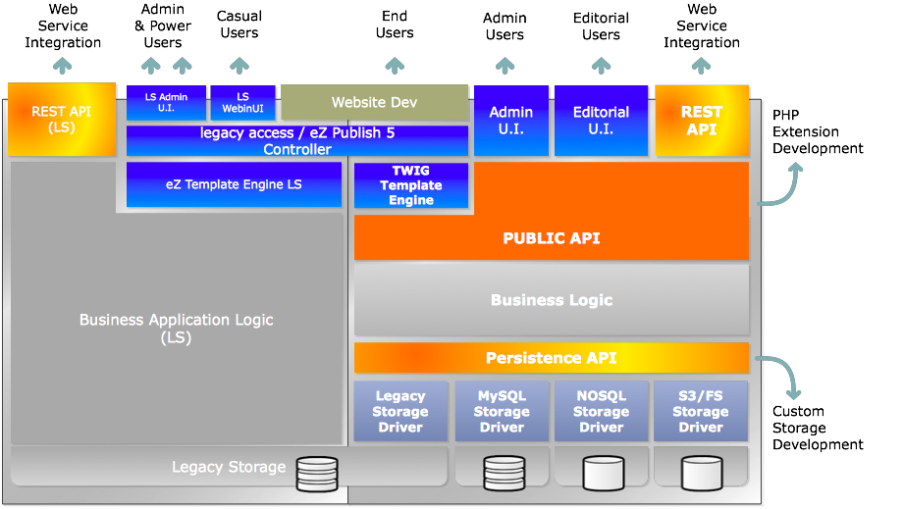
eZ Publish 5 - Architecture
Copyright © 2013 eZ Systems AS - Florent Huck & Philippe Vincent-Royol

Slide 6
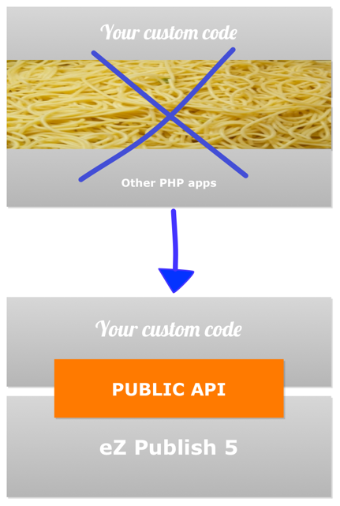
eZ Publish Public API
For the first time ever, a Public API for eZ Publish: a major step forward!
All the CMS features available from PHP code
easier to develop import/export scripts
easier to add new content mgmt interfaces
A clear API definition, which means better documentation for developers
Allows refactoring of core code for improved performance, scalability, etc… while having
long term backward compatibility of your custom developments
Fully extensible, extend it with your custom features relying on the same framework
Copyright © 2013 eZ Systems AS - Florent Huck & Philippe Vincent-Royol

Slide 7
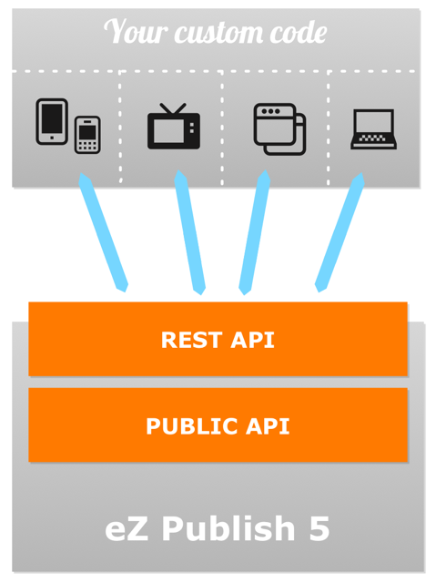
eZ Publish Rest API v. 2
With version 5, eZ Publish REST API covers the whole scope of the content management engine and not only a limited part (read only)
The REST API fully relies now on the Public API for better maintainability and simplicity
It is the reliable and maintainable for:
Native mobile applications
Integration in existing business applications
Social Media Integrations
Any other application (desktop application, internet TV apps…)
Copyright © 2013 eZ Systems AS - Florent Huck & Philippe Vincent-Royol

Slide 8
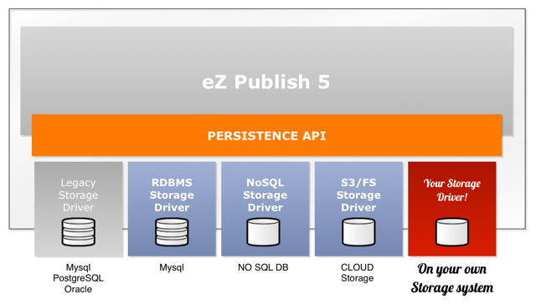
Handle big data content repositories
» eZ Publish 5 is the first content management platform designed to handle Big Content & Big Data!
A clear goal to provide Relational, NoSQL and Hybrid storage system
A persistence API enabling (eZ or 3rd party) to develop the support of any storage system
Long term backward compatibility of your custom developments
Bridging eZ Publish 4.x storage system for backward compatibility with legacy
Copyright © 2013 eZ Systems AS - Florent Huck & Philippe Vincent-Royol

Slide 9



Symfony2, a new Web framework for eZ Publish
Benefits & Opportunities
» eZ Publish 5 integrates the Symfony 2 framework. What does this mean?
A whole new framework available for developers
Extensible HMVC structure
Clean and maintainable modularity via native dependency injection
Easier to merge your custom apps with eZ Publish
A wide range of existing resources on top of Symfony
A new template engine: Twig
Enhanced rendering speed
Easier and more extensible templating language
Support of hierarchical requests
Better IDE support
Copyright © 2013 eZ Systems AS - Florent Huck & Philippe Vincent-Royol
Notes:
HMVC : Hierarchical model–view–controller (HMVC) is a software architectural pattern, a variation of Model–view–controller (MVC) similar to Presentation-abstraction-control (PAC) The main difference between HMVC and PAC is that HMVC is less strict in that it allows the view and model of each agent to communicate directly, thus bypassing the controller.
The controller has some oversight. The controller selects the model and then selects the view, so there is an approval mechanism by the controller. The model prevents the view from accessing the data source directly.

Slide 10

Symfony2, a new Web framework for eZ Publish
Advantages & Disaventages
Advantages
Knowledgeable Community
Standardization
Time saving
Re-usability of code
Re-usability of knowledge
Reduced maintenance costs at the component level
Faster introduction of new features
Faster development of items such as alternate database options
Faster and more efficient kernel
Disavantages
New development APIs to learn
Porting of legacy code
Transition period
No more excuses not to do your work
Copyright © 2013 eZ Systems AS - Florent Huck & Philippe Vincent-Royol
Notes:
HMVC : Hierarchical model–view–controller (HMVC) is a software architectural pattern, a variation of Model–view–controller (MVC) similar to Presentation-abstraction-control (PAC) The main difference between HMVC and PAC is that HMVC is less strict in that it allows the view and model of each agent to communicate directly, thus bypassing the controller.
The controller has some oversight. The controller selects the model and then selects the view, so there is an approval mechanism by the controller. The model prevents the view from accessing the data source directly.

Slide 11

What’s change ?
eZ Publish Evolution
Copyright © 2013 eZ Systems AS - Florent Huck & Philippe Vincent-Royol

Slide 12
What Changes?
Legacy system :
is an old method, technology, computer system, or application program. The legacy system may or may not remain in use. Even if it is no longer used, it may continue to impact the organization due to its historical role.
(Wikipedia)
Changes
Online resources
File structure
API
Terminology
Feature implementation
Copyright © 2013 eZ Systems AS - Florent Huck & Philippe Vincent-Royol

Slide 13
File structure
/ez5
ezpublish configurations, cache, logs
ezpublish_legacy the full Legacy Stack
… incl. legacy extensions
src your bundles
vendor libraries from 3rd parties
ezystems Kernel and 3 bundles (core, legacy, rest)
web all files which are accessible from the web
Static assets are either copied or symlinked from legacy designs / extensions into the web directory via a cli script
Different rewrite rules are needed
Per-environment configuration is managed via different frontend controllers in the web directory
Copyright © 2013 eZ Systems AS - Florent Huck & Philippe Vincent-Royol

Slide 14
Terminology
Translation 4.x to 5.x – content model
4.x | 5.X
Content Class | ContentType
Content Class Group | ContentTypeGroup
Datatype | FieldType
Node | Location
Content Object | Content (meta info in ContentInfo)
Content Object Version | VersionInfo
Content Object Attribute | Field + FieldValue
Content Class Attribute | FieldDefinition
Copyright © 2013 eZ Systems AS - Florent Huck & Philippe Vincent-Royol

Slide 15
Features
Translation 4.x to 5.x – feature implementation
4.x | 5.X
eZ Publish Template | Twig Template
Extension | Bundle
Module | Controller class (based on eZ\Bundle\EzPublishCoreBundle\Controller)
View | Controller action
Fetch function | Replaced by controller+view, the template "fetch" function is replaced by "render"
Template operator | Filter + function
settings/ | ezpublish/config and Resources/config on each bundles
site.ini | ezpublish.yml

Slide 16
What Changes
Feature translation 4.x to 5.x – all the rest
As of 5.0, some features are not implemented on the new stack, such as:
Admin Interface; content editing
Cluster Mode (works now with eZ 5.1+)
Information Collectors
Workflows
Notifications
eZ Find
eZ Flow (display of «layout» attribute) (5.1+ includes read part)
Multisite with a repository (works now with eZ 5.1+)
Documentation is an effort under way.
You can participate too!

Slide 17
Online resources
Issue Tracker: http://jira.ez.no
Developer documentation: https://confluence.ez.no/display/EZP/eZ+Publish+Documentation
API docs:
http://ezsystems.github.com/ezpublish-kernel/phpDocumentor/
http://pubsvn.ez.no/
Also the doc folder inside vendor/ezsystems/ezpublish
Source code:
https://github.com/ezsystems/ezpublish-legacy => the 4.x code, a.k.a. Legacy Stack
https://github.com/ezsystems/ezpublish-kernel => the new kernel (incl. Public API)
https://github.com/ezsystems/ezpublish-community => pulling it all together
Tutorials: http://share.ez.no as always
eZ 5 CheatSheet https://github.com/dspe/ez5_cheatsheet

Slide 18
That's one small step for a developper ...
Notes:
The following 4 slides allow you to dig deeper into the eZ approach and talk in more specifics about agility, connectivity and empowerment.

Slide 19
eZ Publish 5 – Development mode
Activated via a custom controller in the new kernel
Debug toolbar at bottom of the screen – always in view
Full featured profiler
Saves data of every profiler run
Exception handling gets stricter
Easier to keep separate settings per-environment
DebugOutput still available when running legacy modules
More customizable in 5.2+ and 2013.5. Have a look at https://github.com/ezsystems/ezpublish-community/pull/51

Slide 20

eZ Publish 5 configuration model
The eZ 5’s configuration model uses Symfony2’s configuration model : YML files
A YML file contains settings that control behavior of a specific part of eZ Publish
ezpublish.yml is the most important YML file
config.yml to configure some behavior with Symfony2 for example
Etc …
Settings are managed
manually (by editing the YML file with a text editor)

Slide 21
eZ Publish Dynamic Configuration
Dynamic configuration with the ConfigResolver can be resolved depending on a scope.
Available scopes are (in order of precedence)
Global: ezsettings.global.field_templates
Siteaccess: ezsettings.ezdemo_site.field_templates
Group: ezsettings.my_siteaccess_group.field_templates
Default: ezsettings.default.field_templates
Your dynamic settings must comply internally to the following name format:
<namespace>.<scope>.parameter.name

Slide 22
Dynamic configuration example
eZ Publish app configuration - YML configuration : ezpublish.yml
ezpublish:
system:
ezspace:
field_templates:
- { template: EztTrainingBundle:FieldType:content_fields.html.twig, priority: 0 }
Bundle configuration - Syntactic configuration : parameters.yml
parameters:
ezsettings.ezspace.field_templates :
- { template: EztTrainingBundle:FieldType:content_fields.html.twig, priority: 0 }

Slide 23
eZ Publish 5 – BC

Slide 24
Fallback Routing & Content view
All URIs wich are not matched by Symfony controllers are sent to the Legacy Stack
All existing functionality is thus preserved
Including custom modules
Including url-aliases
For speed, this can be optimized via configuration (f.e. for Admin Interface)
Sf controller in use: LegacyKernelController::indexAction
Content is rendered using the ViewController ::viewLocation controller
Class located in Core\MVC\Symfony\Controller\Content
It uses a twig template for pagelayout: pagelayout.html.twig in DemoBundle
(set in parameters.yml)
And a ViewManager to find the appropriate template for the current Location. We will use the template selection rules.

Slide 25
Legacy template fallback
When falling back to the legacy kernel, the old content/view module is run to return the appropriate view for the given content.
However, the pagelayout is not rendered as it needs to be still rendered by Twig in the Symfony part, for consistency. In this regard, the system uses the Decorator design pattern to include the generated view in your layout.
parameters:
# Base layout for legacy fallback
ezpublish_legacy.my_siteaccess.view_default_layout: AcmeDemoBundle::pagelayout.html.twig
# Block name ezpublish.content_view.content_block_name: content
# Module Layout
ezpublish_legacy.my_siteaccess.module_default_layout: AcmeDemoBundle::pagelayout_legacy.html.twig

Slide 26
Pagelayout example
Example of pagelayout.html.twig
<!DOCTYPE html>
<html>
<head>
<!-- Insert everything you need here that is common -->
</head>
<body>
{% block content %}{# Regular content will be inserted here #}{% endblock %}
</body>
</html>
Example of pagelayout_legacy.html.twig
{% extends "AcmeDemoBundle::pagelayout.html.twig" %}
{% block content %}
{# module_result variable is received from the legacy controller. #}
{{ module_result.content|raw }}
{% endblock %}

Slide 27
Some usefull tools
Display a location
{{ render( controller("ez_content:viewLocation", { "locationId": 123, "viewType": "full" } )) }}
Display a field
{{ ez_render_field( content, "my_field" ) }}
Include a legacy template
{% include "design:my_folder/my_template.tpl" with {"my_key" : "my_value" } %}

Slide 28
Some usefull twig helper
Property | Description
ezpublish.siteaccess | Returns the current siteaccess
ezpublish.requestUriString | Returns the request URI string
ezpublish.systemUriString | Return the systems URI string
ezpublish.viewParameters | Return the view parameters as a hash
ezpublish.viewParametersString | Return the view parameters as a string
ezpublish.siteName | Return the name of the current siteaccess
ezpublish.legacy | Returns legacy information
Legacy
Property | Description
ezpublish.legacy.all | Return all parameters
ezpublish.legacy.keys | Returns the parameter keys only
ezpublish.legacy.get | Returns a parameter by name
ezpublish.legacy.has | Returns true if the parameter is defined

Slide 29
Template selection rules system
Simplified view
Of course, eZ Publish is a (little) bit more complex but you could remember that
default template (example.tpl / example.html.twig)
Do we provide an template selection rules?
(override.ini / ezpublish.yml)
"Override" template
Default template

Slide 30
Template selection rules - Configuration
Example from ezpublish.yml
ezpublish:
system:
my_siteaccess:
location_view:
full:
welcome_page:
template: AcmeDemoBundle:full:welcome.html.twig
match:
Id\Location: 2
article_full:
template: AcmeDemoBundle:full:article.html.twig
match:
Identifier\ContentType: article
preview:
article_preview:
template: AcmeDemoBundle:preview:article.html.twig
match:
Identifier\ContentType: [article, news]
location_view and content_view are available in override system

Slide 31
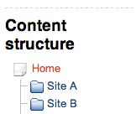
Multisite – One repository
eZ Publish 5.1 provide a way to build multiple website with a single repository, in different subtrees of content. This system will be extends on next releases.
ezpublish:
system:
my_siteaccess:
content:
tree_root:
# Root locationId. Default is top locationId
location_id: 123
# Every URL aliases starting with those prefixes will be # considered being outside of the subtree starting at
# root_location.
# Default value is an empty array.
# Prefixes are not case sensitive.
excluded_uri_prefixes:
- media
- users

Slide 32
Bonus
Coding Standard !

Slide 33

Coding Standard
Be awesome, use coding standards
When contributing code to eZ Publish, you must follow its coding standards.
Remember that the main advantage of standards is that every piece of code looks and feels familiar, it’s not about this or that being more readable.
Use PHP Code Sniffer !
Install eZ v2 PHPCodeSniffer standard (http://github.com/ezsystems/ezcs)
https://github.com/ezsystems/ezpublish-kernel/wiki/codingstandards

Slide 34
Exercise
Installation & our first bundle !

Slide 35
... one giant leap for production !
Notes:
The following 4 slides allow you to dig deeper into the eZ approach and talk in more specifics about agility, connectivity and empowerment.

Slide 36
Cache - Reminder
Cache me if you can !
The goal of caching in HTTP/1.1 is to eliminate the need to send requests in many cases, and to eliminate the need to send full responses in many other cases
Types of caches
Browser caches: the browser cache is a private cache as cached resources aren't shared with anyone else
Proxy caches: a proxy is a shared cache as many people can be behind a single one
Gateway caches: (a.k.a. Reverse Proxy) like a proxy, it's also a shared cache but on the server side
More informations about HTTP Rfc: http://tools.ietf.org/html/draft-ietf-httpbis-p6-cache-21
Copyright © 2013 eZ Systems AS (except where otherwise noted). All rights reserved.

Slide 37
Reminder: HTTP caching
Caching headers
HTTP 1.1 specifies multiple response cache headers that can be used to control caching behavior:
Cache-Control => can control public/private as well as TTL
Expires, Max-age => sets a TTL for the given resource
Etag => used to revalidate a resource which is already in a cache (note: E-tag is removed on eZ 5.1)
Last-Modified => used to calculate a default TTL if no expiration date is set or as weak validator
Side note: compression of content is also a good idea to make web pages load faster
But take care about gateway caches having to store N versions of each resource
Copyright © 2013 eZ Systems AS (except where otherwise noted). All rights reserved.
Notes:
Note: expiry headers for static resources are generally set via Apache configuration, as well as compression of response

Slide 38
Reminder: HTTP caching
Validation vs. Expiration
Two caching models are available:
Validation
the client always checks if the resource it has in its cache is valid (1 network roundtrip)
It gets back a “fast” answer (HTTP 304 with no body) if resource dis not change: good
Expiration
Along with the 1st response, the server sends to the client a TTL
As long as the TTL is not expired, the client does not request the resource again
This saves one network roundtrip per resource: better
But it makes it hard to have a TTL if resources can change on random schedule
Workaround: use different URL for each version of resource (e.g. ezjscore, content images)
If there is a gateway cache, a PURGE command can be used to overcome this, forcing a refresh of the resource before the TTL is expired
Copyright © 2013 eZ Systems AS (except where otherwise noted). All rights reserved.
Notes:
NB: one network roundtrip = esp. important for mobile clients, where latency is high

Slide 39
Expiration Model 1/2
Including either or both of the Cache-Control: max-age=N or Expires headers
Rick
Cache
Backend
Get /welcome
Get /welcome
« Hello eZ »
With max age header
200 OK Cache-Control: maxAge=60 « Hello eZ »
200 OK Cache-Control: maxAge=60 « Hello eZ »
Rick
Cache
Backend
Copyright © 2013 eZ Systems AS (except where otherwise noted). All rights reserved.

Slide 40
Expiration Model 2/2
Including either or both of the Cache-Control: max-age=N or Expires headers
Bob
Cache
Backend
Get /welcome
This does not happen …
200 OK Age = 40 Cache-Control: maxAge=60 « Hello eZ »
… because the cache is fresh
Bob
Cache
Backend
Copyright © 2013 eZ Systems AS (except where otherwise noted). All rights reserved.

Slide 41
Validation Model 1/2
Rick
Cache
Backend
Get /welcome
Get /welcome
200 OK Last Modified: Mon, 12 March ETag: a3f5gg6d « Hello eZ »
« Hello eZ »
200 OK Last Modified: Mon, 12 March ETag: a3f5gg6d « Hello eZ »
Rick
Cache
Backend
Copyright © 2013 eZ Systems AS (except where otherwise noted). All rights reserved.

Slide 42
Validation Model 2/2
Bob
Cache
Backend
Get /welcome
If-Modified-Since: Mon, 12 March If-Node-Match: a3f5gg6d
Get /welcome
Do not generate response
200 OK Last Modified: Mon, 12 March ETag: a3f5gg6d « Hello eZ »
304 Not Modified
Bob
Cache
Backend
Copyright © 2013 eZ Systems AS (except where otherwise noted). All rights reserved.

Slide 43
Combining Expiration & Validation models 1/3
Rick
Cache
Backend
Get /welcome
Get /welcome
200 OK Cache-control : maxage=60 Last-Modified: Mon, 12 March « Hello eZ »
« Hello eZ »
200 OK Cache-control : maxage=60 Last-Modified: Mon, 12 March « Hello eZ »
Rick
Cache
Backend
Copyright © 2013 eZ Systems AS (except where otherwise noted). All rights reserved.

Slide 44
Combining Expiration & Validation models 2/3
Rick comes back after 40s …
Rick
Cache
Backend
Get /welcome
This does not happen …
200 OK Cache-control : maxage=60 Age: 40 Last-Modified: Mon, 12 March « Hello eZ »
… because the cache is fresh
Rick
Cache
Backend
Copyright © 2013 eZ Systems AS (except where otherwise noted). All rights reserved.

Slide 45
Combining Expiration & Validation models 3/3
Bob make the same request, 50 seconds after Rick …
Bob
Cache
Backend
Get /welcome
Get /welcome
If-Modified-Since: Mon, 12 March
Do not generate response
200 OK Cache-Control: maxage=60 Last-Modified: Mon, 12 March « Hello eZ »
304 Not Modified Cache-Control: maxage=60
Bob
Cache
Backend
Copyright © 2013 eZ Systems AS (except where otherwise noted). All rights reserved.

Slide 46
Reminder: Symfony2 cache I/II
Concepts
Gateway Cache, or reverse proxy, is an independent layer that sits in front of your application (it can be within Symfony or external). The reverse proxy caches responses as they're returned from your application and answers requests with cached responses before they hit your application code
HTTP cache headers are used to communicate with the gateway cache and any other caches between your application and the client. Symfony2 provides a powerful interface for managing the cache headers
HTTP expiration and validation are the two models used for determining whether cached content is fresh (can be reused from the cache) or stale (should be regenerated by the application)
Edge Side Includes (ESI) allow HTTP cache to be used to cache page fragments (even nested fragments) independently. With ESI, you can f.e. cache an entire page for 60 minutes, but an embedded sidebar for only 5 minutes
More info: http://symfony.com/doc/current/book/http_cache.html
Copyright © 2013 eZ Systems AS (except where otherwise noted). All rights reserved.

Slide 47
eZ Publish 5 : HttpCache
Content cache
eZ Publish uses the Symfony HttpCache to manage content cache, with both expiration and validation model
An ETag is computed for every content/version and sent in the response
It is also possible to use the expiration model to get lightning fast responses
Default configuration
ezpublish:
system:
my_siteaccess:
content:
view_cache: true # Activates HttpCache for content
ttl_cache: true # Activates expiration-based HttpCache for content (very fast)
default_ttl: 60 # Number of seconds an Http response is valid in cache (if ttl_cache is true)
An additional X-Location-Id header is added in the response for identification
The HttpCache is disabled for the dev environment
Copyright © 2013 eZ Systems AS (except where otherwise noted). All rights reserved.
Notes:
Todo: Q1: is this valid for content/XXX as well? Q2: is this valid for REST?

Slide 48
eZ Publish 5 : HttpCache
Making your controller content-cache aware
You can tie the response of a custom controller to a particular Location id
It will be cached by default in the Gateway Cache
It will be automatically expired when that content is published again
use Symfony\Component\HttpFoundation\Response;
// In a controller
// "Connects" the response to location #123 and sets a max age (TTL) of 1 hour.
$response = new Response();
$response->headers->set( ‘X-Location-Id’, 123 );
$response->setSharedMaxAge( 3600 );
Copyright © 2013 eZ Systems AS (except where otherwise noted). All rights reserved.

Slide 49
eZ Publish 5 : Purge
The PURGE mechanism complements the standard validation+expiration model
It is only useful in presence of a Gateway Cache
It gives the best of both worlds (large TTL and fresh content)
On publish, one or several Http PURGE requests are sent to the Gateway Cache
This request will have a specific header:
X-Location-Id (in the case of 1 request per location to purge), or
X-Group-Location-Id (in the case of 1 request for all locations to purge)
Emulated purge request
Default mode
No Http requests will be sent to an external Gateway Cache when publishing
Works with the internal Httpcache
ezpublish:
http_cache:
purge_type: local
Copyright © 2013 eZ Systems AS (except where otherwise noted). All rights reserved.

Slide 50
eZ Publish 5 : Purge
Managing external gateways
One purge request per location, aka «MultipleHttp»
purge_type: multiple_http
One purge request for all locations, aka «SingleHttp» (X-Group-Location-id header)
purge_type: single_http
NB: needs specific code for varnish to work with (C language plugin)
Gateway cache server address
purge_servers: [ "http://varnish.server1/", "http://varnish.server2/" ]
Purge all contents
On response, you will have an header like this:
X-location-Id: *
Copyright © 2013 eZ Systems AS (except where otherwise noted). All rights reserved.

Slide 51
eZ Publish 5 : Purge
Manual purging
You can expire the content cache for any location you desire
$locationIds = array( 123, 456 );
$container->get( ‘ezpublish.http_cache.purger’ )->purge( $locationIds );
$container->get( ‘ezpublish.http_cache.purger’ )->purgeAll();
Copyright © 2013 eZ Systems AS (except where otherwise noted). All rights reserved.

Slide 52
eZ Publish 5 : ESI support
To use ESI blocks with a reverse proxy :
VirtualHost is pointing on index.php
Don’t load EzPublishCache() in index.php (only if you are using a reverse proxy)
=> otherwise Symfony2 will use internal reverse proxy and send to the real reverse proxy the HTML result of ESI blocks
Copyright © 2013 eZ Systems AS (except where otherwise noted). All rights reserved.

Slide 53

Varnish Cache
Varnish Cache is a web application accelerator also known as a caching HTTP reverse proxy.
You install it in front of any server that speaks HTTP and configure it to cache the contents. Varnish Cache is really, really fast. It typically speeds up delivery with a factor of 300 - 1000x, depending on your architecture.
A high level overview of what Varnish does can be seen in the video attached to this web page.
https://www.varnish-cache.org/about

Slide 54
Varnish Cache – How to ?
eZ Publish 5.x was tested with last major release of Varnish Cache ( 3.x ).
All informations about installation, configuration are located here:https://www.varnish-cache.org/docs/3.0/installation/index.html
How to start Varnish ? Two ways:
Manually
varnishd -f /usr/local/etc/varnish/default.vcl -s malloc,1G -T 127.0.0.1:2000 -a 0.0.0.0:8080
Init Script
About varnish configuration (On Debian/Ubuntu OS):
You have to modify your /etc/default/varnish file (configuration used by init.d script)
For all Operating Systems, modify or create a new vcl file ( /etc/varnish/default.vcl)

Slide 55
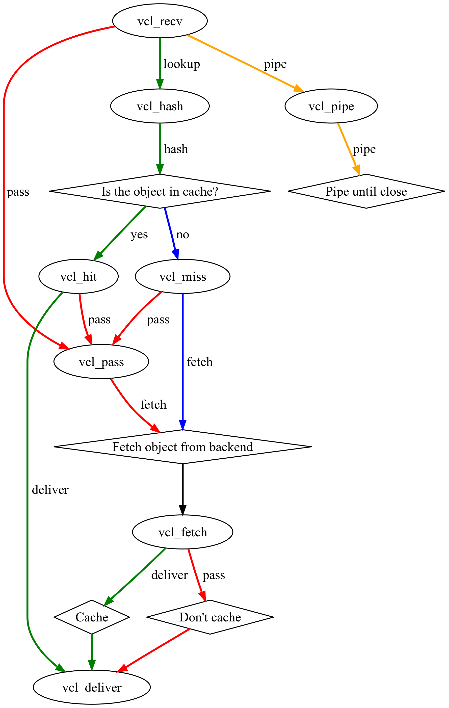
Varnish - Vcl
vcl_recv: is the first VCL function executed, right after Varnish has decoded the request into its basic data structure
vcl_hash: defines what is unique about a request
vcl_hit: right after an object has been found in the cache
vcl_miss: right after an object was looked up and not found in cache
vcl_fetch: is the backend-counterpart to vcl_recv. Return deliver, tells Varnish to cache, returning hit_for_pass tells it not to cache, but does not run the vcl_pass function of VCL for this specific client.

Slide 56
Varnish VCL and eZ Publish 5
A dedicated VCL could be found on confluence https://confluence.ez.no/display/EZP/Using+Varnish
Be careful: only multiple_http is implemented on this example. If you would like to switch to single_http, you have to create a Vmod or add some C code.
Some tools to debug with Varnish:
varnishlog
varnishadm

Slide 57
Exercise
eZ Publish 5 and Varnish

